Slide 1

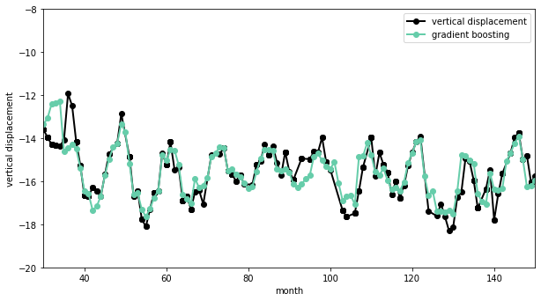
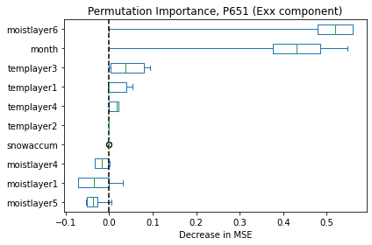
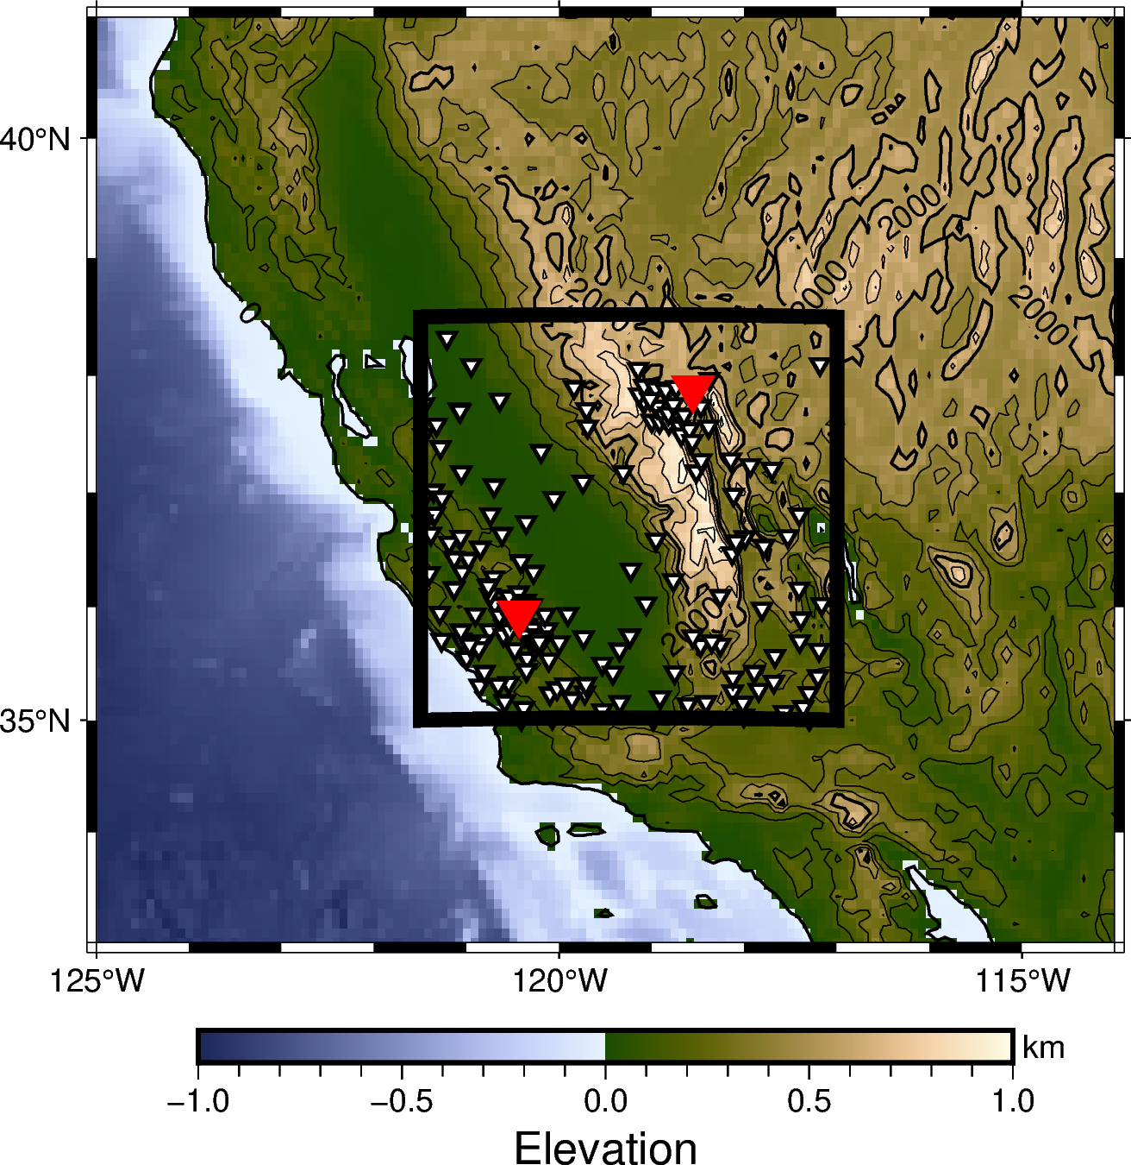
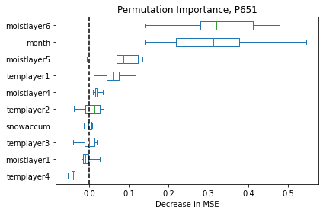
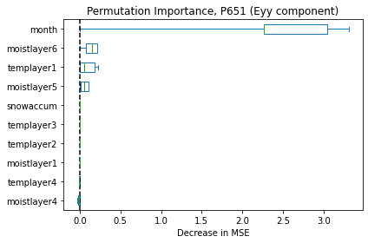
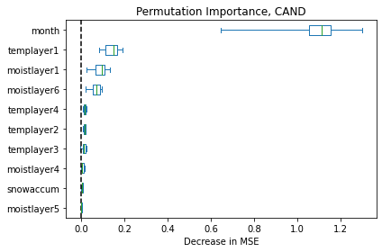


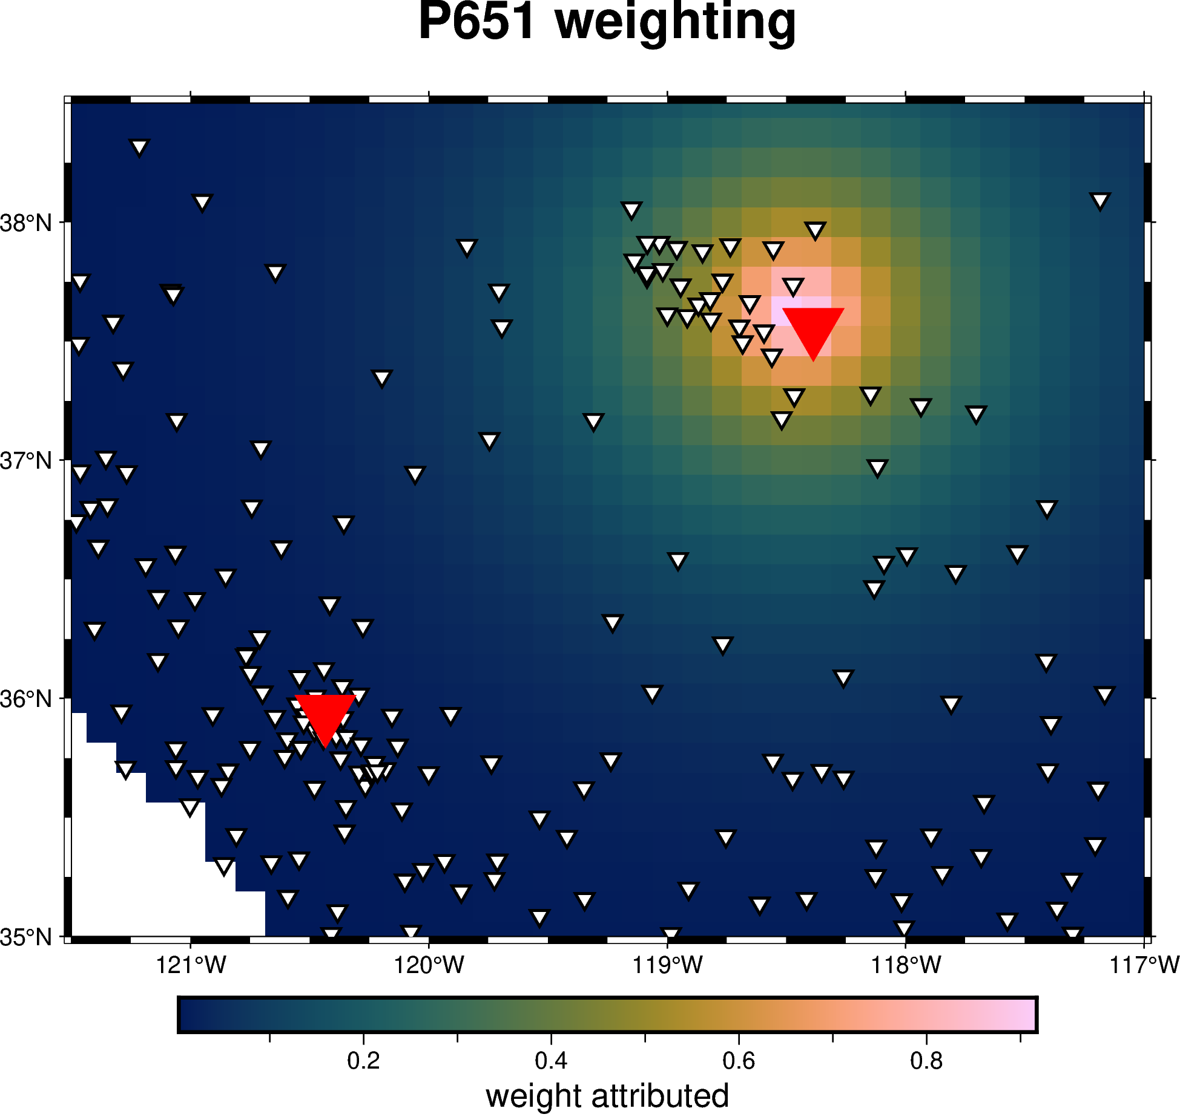
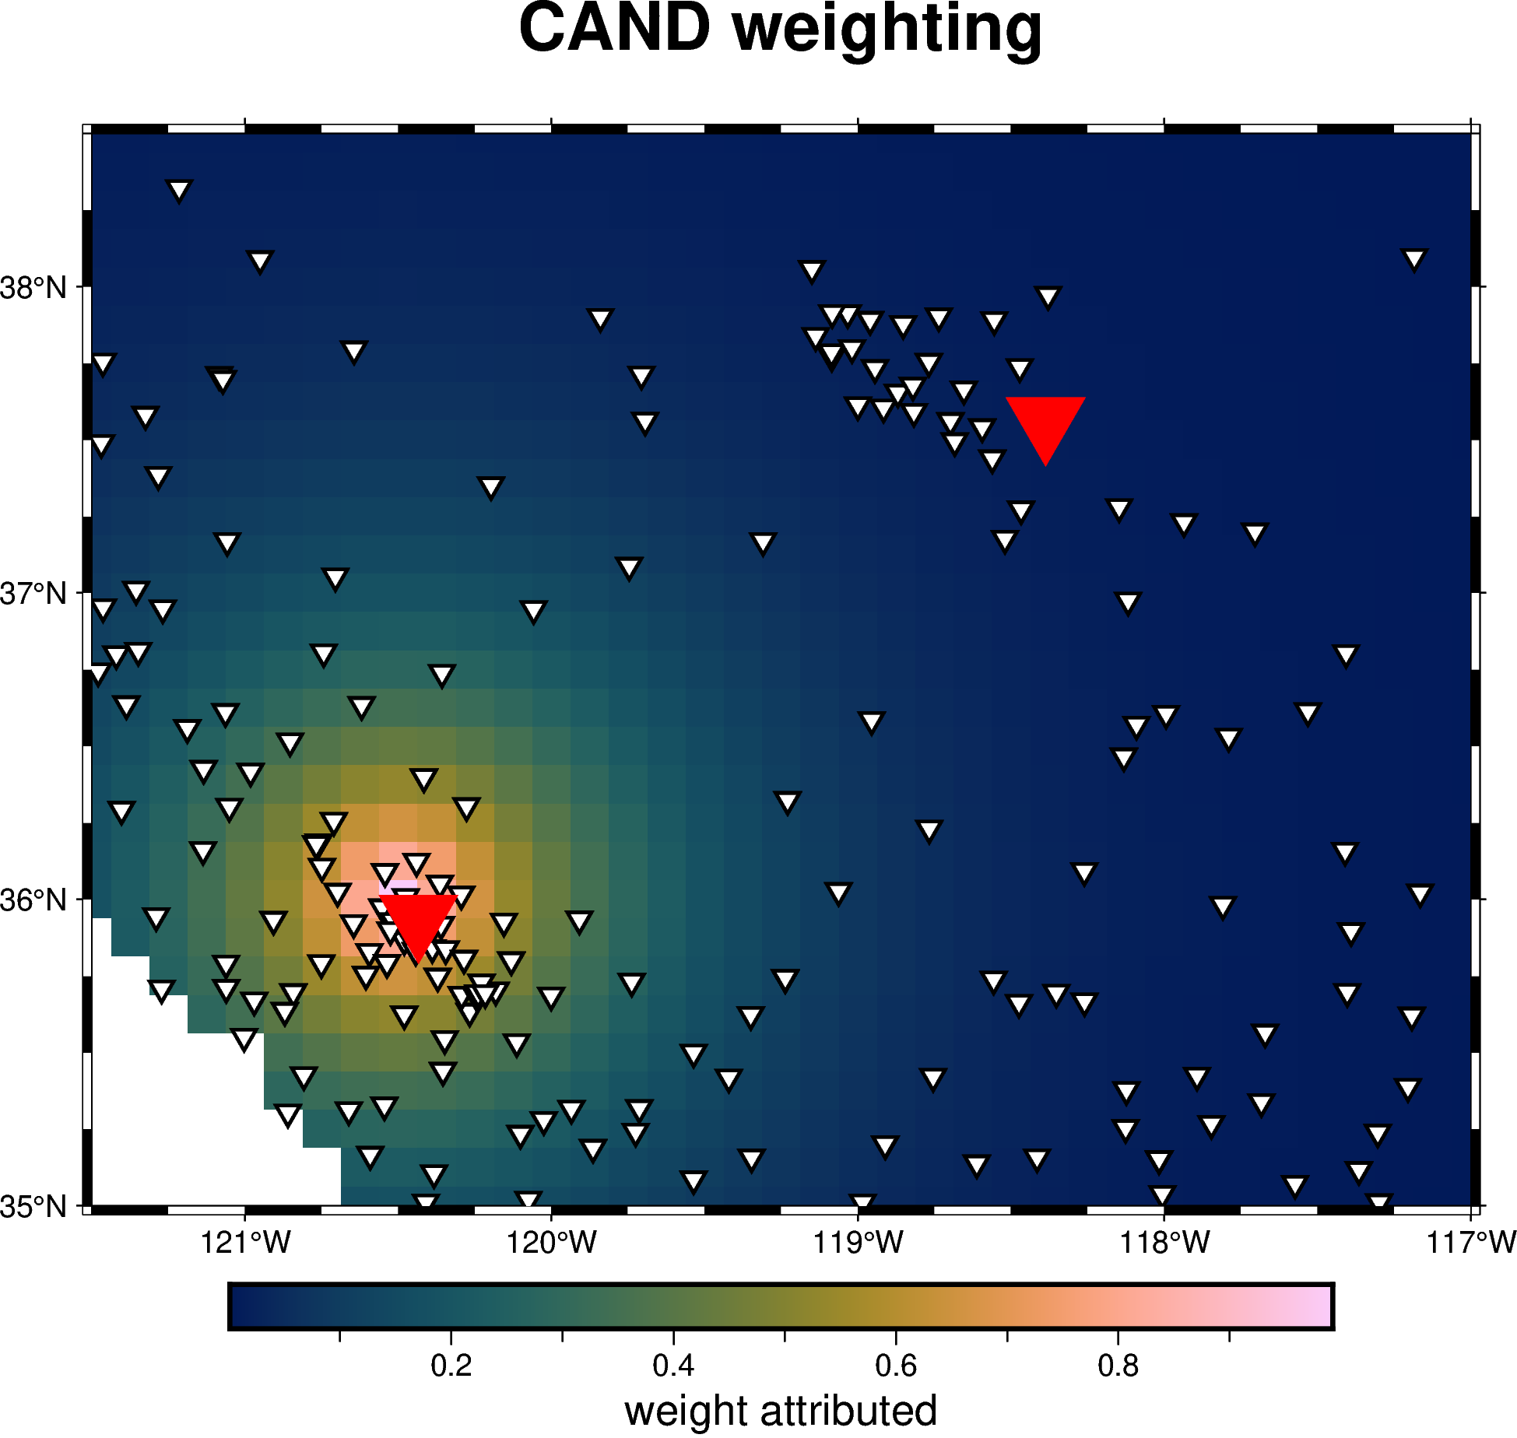
Multi-output gradient tree boosting for crustal displacement forecasting from weather variables in California
Diego Luca Gonzalez Gauss ¹², Jeonghyeop Kim ², William E. Holt ², Mradula Vashishitha ²
Brookline High School, 115 Greenough St, Brookline, MA 02445 ¹; Stony Brook University, 100 Nicolls Rd, Stony Brook, NY 11794 ²
Introduction
6a
Results
Discussion
NLDAS' Noah Land Surface Model (LSM) provides American weather data in a 0.125° grid
GNSS data provide displacements for GNSS stations and underlying crustal movement
Water load is hypothesized to spur a crustal elastic response
Region of interest (35-38.5° N, 117-121.5° W) includes Parkfield and Long Valley Caldera
We forecast GNSS displacement data from Noah weather variables
5a
Gradient boosting MSEs suggested by stations CAND and P651 outperform existing benchmark physical models
Using temporal and thermoelastic data makes gradient boosting powerful when modeling "wet winters", droughts or other events that inspire long-term dependencies
Gradient boosting is predictably worse at forecasting f_{k+1, k+2} when trained for low k
From the approximations used when quantifying tree node gain and geospatial relationships, the framework still has inaccuracies that can be approached with more complex techniques
From the success of weighting in constructing the gradient boosting model, interpolating crustal displacement between stations is a future task.
Managing runtime will be an issue given the scope of the data. The scalability of the model is a future task as well
6b
Figure 4 (above). The vertical displacement for station CAND from July 2009 to July 2019 and vertical displacement predicted by the gradient boosting model.
Multi-output gradient boosting saw an averaged 1.31 MSE for station CAND and 1.16 MSE for station P651
Deep subsurface soil moisture is informative to horizontal displacement, while vertical displacement is largely informed by previous years'
5b
Figure 1. A map of all GNSS stations in the observed area, with emphasis on stations CAND (by Parkfield, bottom left) and P651 (by Long Valley Caldera, top right).
Figure 5 (left). Permutation importance for features in predicting 5a) P651 and 5b) CAND displacement.
Figure 6 (above). Permutation importance for features in predicting P651 6a) horizontal and 6b) vertical displacement.
Methods
References and acknowledgements
2a
Reformatted Noah LSM and GNSS data as long-wavelength (monthly) time series through tensor manipulation
Used multiple output gradient tree boosting model to predict displacement GNSS station displacement, and incorporate information from the existing dependency between GNSS displacement values
Features include subsurface soil moisture from 0-10cm, 10-40cm, 40-100cm, and 100-200cm; snow depth; and, subsurface soil temperature from 0-10cm, 10-40cm, 40-100cm, and 100-200cm
Trained with datasets generated from a k-fold cross-validation approach of 6 month folds to forecast a year of folds f_{k+1, k+2} from f_{1... k} using data ranging from January 2007 to July 2019
Uses histogram-based feature binning and diagonal approximation of objective function to limit runtime
Novel introduction of geospatial information through a weight of form e^{⁻||r||}, incorporating weather data from nearby Noah LSM grid points for modeled stations as allotted by weight
Gauges the accuracy of the model using stations CAND and P651, cataloguing mean squared error (MSE) in displacement predictions over tree iterations. The approximation of node objective function incorporates MSE for all predicted values simultaneously
Calculated permutation feature importance for the multiple output model, as well as for two single output models predicting horizontal and vertical displacement independently
[1] Hu, X., Bürgmann, R., Xu, X., Fielding, E., & Liu, Z. (2021). Machine-learning characterization of tectonic, hydrological and anthropogenic sources of active ground deformation in California. Journal of Geophysical Research: Solid Earth, 126, e2021JB022373.
[2] Puskas et al. (2017). Hydrologic Loading Model Displacements from the National and Global Data Assimilation Systems (NLDAS and GLDAS).
[3] Si Si et al. (2017). Gradient Boosted Decision Trees for High Dimensional Sparse Output. Proceedings of the 34th International Conference on Machine Learning, Sydney, Australia. PMLR 70.
[4] Stewart et al. (2022). TorchGeo: Deep Learning With Geospatial Data (Systems Paper).
[5] Yash Narayan, Jeonghyeop Kim and William Holt (2021). DeepQuake: Artificial Intelligence for Earthquake Forecasting Using Fine-Grained Climate Data. 35th Conference on Neural Information Processing Systems (NeurIPS 2021), Vancouver, Canada.
[6] Zhendong Zhang and Cheolkon Jung (2020). GBDT-MO: Gradient Boosted Decision Trees
for Multiple Outputs. IEEE Transactions on Neural Networks
We thank the Simons Summer Research Fellowship and Stony Brook University for this opportunity. All correspondence should be sent to luca.gonzalezgauss@gmail.com.
2b
Figure 2 (above). 2a) True objective function of tree node given in [6] 2b) Diagonal approximation for objective function of tree node
Figure 3 (below). Weights attributed to grid points for nearby stations 3a) P651 and 3b) CAND as given by the weighting estimator e^{⁻||r||}.
3a
3b

